Slide 1
CS 371 Artificial Intelligence
Fall 2023

Slide 2


Slide 3


Question
How would you get to Northern Areas of Pakistan on Weekend in the least amount of time?
Drive Yourself
Bus Transport
Railway
By Air

Slide 4
Course Plan
Search problems
Markov decision processes
Adversarial games
Constraint satisfaction problems
Bayesian networks
Reflex
States
Variables
Logic
Low Level Intelligence
High Level Intelligence
Artificial Intelligence

Slide 5
Markov Decision Process

Slide 6

Search Problems
F
B
D
C
G
A
E
You deterministically move
From one state to another`
Deterministic Decision
Successor State/
Next State
State, Action

Slide 7
Deterministic Vs Stochastic Models: Pros and Cons
Deterministic. It allows to calculate a future event exactly with certainty, without the involvement of randomness. You have all the necessary data.
Pros
The benefit of simplicity.
Easier to understand
Cons
Unable to consider ongoing variables
Unable to consider future risks
Less realistic
Stochastic. Having a random probability distribution or pattern that may be analyzed statistically but may not be predicted precisely. Uncertain
Pros
It reflects real-world providing a range of possible outcomes
It predicts a range of possible future outcomes
It has the ability to avoid the significant shortfalls inherent in deterministic
Cons
The problem of ignoring specific risks

Slide 8
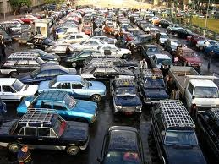
Uncertainty in the real world
State s1
State, Action
Randomness
State s2

Slide 9
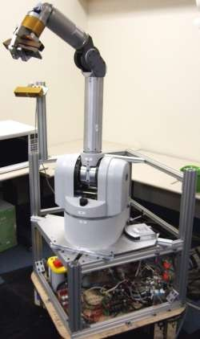


Applications
Robotics: decide where to move, but actuators can fail, hit unseen obstacles, etc.
Resource allocation: decide what to produce, don’t know the customer demand for various products
Agriculture: decide what to plant but don’t know weather and thus crop yield

Slide 10
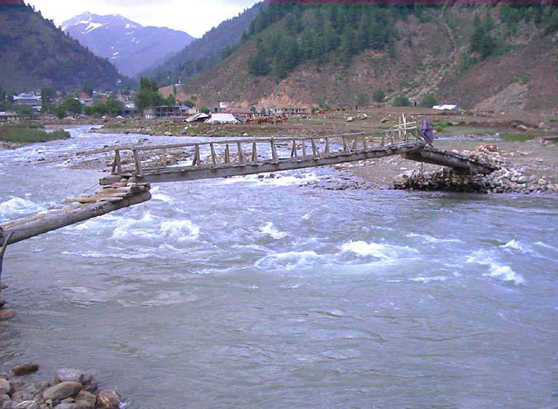
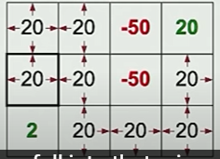
Bridge Crossing
 |  | -50 | 20
 |  | -50
2

Slide 11
Markov Decision Process
Representation and Modelling

Slide 12

Example: Dice Game
For each round r = 1, 2, . . .
You choose stay or quit.
If quit, you get $10 and we end the game.
If stay, you get $4 and then I roll a 6-sided dice.
If the dice results in 1 or 2, we end the game.
Otherwise, continue to the next round.

Slide 13

Example: Dice Game
For each round r = 1, 2, . . .
You choose stay or quit.
If quit, you get $10 and we end the game.
If stay, you get $4 and then I roll a 6-sided dice.
If the dice results in 1 or 2, we end the game.
Otherwise, continue to the next round.

Slide 14
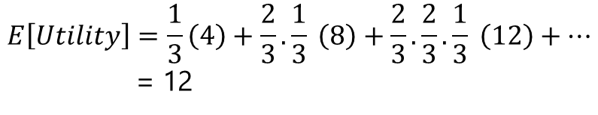
Rewards
If follow policy ”stay”:
If you need to stay then the expected utility reduces with iteration
$$E\left[Utility\right]=\frac{1}{3}\left(4\right)+\frac{2}{3}.\frac{1}{3} \left(8\right)+\frac{2}{3}.\frac{2}{3}.\frac{1}{3} \left(12\right)+…$$
= 12
Expected Utility

Slide 15
Rewards
If follow policy ”quit”:
Expected Utility
1(10) = 10

Slide 16
MDP for Dice Game
Example: Dice Game
For each round r = 1, 2, . . .
You choose stay or quit.
If quit, you get $10 and we end the game.
If stay, you get $4 and then I roll a 6-sided dice.
If the dice results in 1 or 2, we end the game.
Otherwise, continue to the next round.
In
stay
in, stay
(2/3): $4
(1/3) : $4
Chance node
quit
in, quit
end
deterministic node
1: $10

Slide 17
Definition: Markov Decision Process
States: the set of states
s_{start} ∈ States: starting state
Actions(s): possible actions from state s
T (s, a, s′): Tr. probability of s′ if take action a in state s
Reward(s, a, s′): reward for the transition (s, a, s′)
IsGoal(s): whether at end of game
0 ≤ γ ≤ 1: discount factor (default: 1)

Slide 18
Definition: Search Problem
States: the set of states
s_{start} ∈ States: starting state
Actions(s): possible actions from state s
Transition(s, a): where we end up if take action a in state s
Cost(s, a): cost for taking action a in state s
IsGoal(s): whether at end
Transition(s, a) ⇒ T (s, a, s′)
Cost(s, a) ⇒ Reward(s, a, s′)
Difference of search prob & MDP

Slide 19
Definition: Transition Probabilities
The transition probabilities T (s, a, s′) specify the probability of ending up in state s′ if taken action a in state s.
Example: Transition Probabilities
The transition probabilities T (s, a, s′) specify the probability of ending up in state s′ if taken action a in state s.
s | a | s′ | T(s,a, s′)
in | quit | end | 1
in | stay | in | 2/3
in | stay | end | 1/3
We want to stay

Slide 20
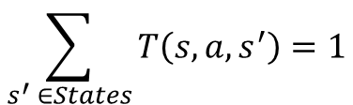
Probabilities sum to one
s | a | s′ | T(s,a, s′)
in | quit | end | 1
in | stay | in | 2/3
in | stay | end | 1/3
For each state s and action a:
Transition prob. Is non-negative
$$\sum_{s^{′} ∈States}{T\left(s,a,s^{′}\right)=1}$$
Successors: s′ such that T (s, a, s′) > 0

Slide 21
Search prob only
Example: Transportation Example
Street with blocks numbered 1 to n.
Walking from s to s + 1 takes 1 minute.
Taking a magic tram from s to 2s takes 2 minutes.
How to travel from 1 to n in the least time?
MDP prob
Tram fails with probability 0.5.

Slide 22
What is the solution?
At state S, what action is performed i.e mapping of states to actions
Search Problem: Path (sequence of actions)
MDP: Policy
Definition: Policy
A policy π is a mapping from each state s ∈ States to an action a ∈ Actions(s).
Example: Bridge Crossing
s | π(s)
(1,1) | S
(2,1) | E
(3,1) | N
 |  | -50 | 20
 |  | -50
2

Slide 23
Policy Evaluation

Slide 24
Definition: Utility
Following a policy yields a random path.
The utility of a policy is the (discounted) sum of the rewards on the path (this is a random quantity).
Path Utility
[in; stay, 4, end] 4
[in; stay, 4, in; stay, 4, in; stay, 4, end] 12
[in; stay, 4, in; stay, 4, end] 8
[in; stay, 4, in; stay, 4, in; stay, 4, in; stay, 4, end] 16
... ...

Slide 25
Definition: Value
The value of a policy is the expected utility.

Slide 26
Evaluation of Policy on Bridge crossing

Slide 27
Discounting
Definition: Discounting
Path:s₀, a₁r₁s₁, a₂r₂s₂, . . .(action, reward, new state).
The utility with discount γ is
u₁ = r₁ + γr₂ + γ²r₃ + γ³r₄ + · · ·
Discount γ = 1
(save for the future): [stay, stay, stay, stay]: 4 + 4 + 4 + 4 = 16
Discount γ = 0
(live in the moment): [stay, stay, stay, stay]: 4 + 0 · (4 + · · · ) = 4
Discount γ = 0.5 (balanced life):
[stay, stay, stay, stay]: 4 + 1 · 4 + · 4 + · 4 = 7.5

Slide 28
Definition: Value of the policy
Let V_{π} (s) be the expected utility received by following policy π from state s

Slide 29
Definition: Q-Value of the policy
Let Q_{π} (s, a) be the expected utility of taking action a from state s, and then following policy π.
Q_{π} (s, π(s))
_{s}′
V_{π} (s′)
V_{π} (s)
s
T (s, π(s), s′)
π(s)
s, π(s)

Slide 30
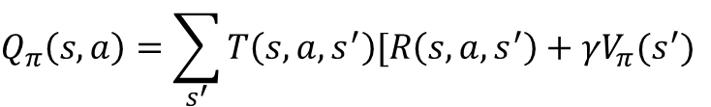
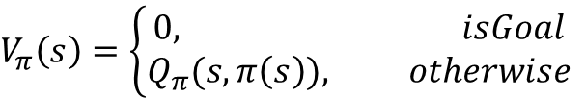
Q_{π} (s, π(s))
_{s}′
V_{π} (s′)
V_{π} (s)
s
T (s, π(s), s′)
π(s)
s, π(s)
$$V_{π}\left(s\right)=\left\{\begin{aligned}0, isGoal \\ &Q_{π}(s, π\left(s\right)), otherwise\end{aligned}\right.$$
$$Q_{π}\left(s,a\right)=\sum_{s^{′}}{T\left(s,a,s^{′}\right)[R\left(s,a,s^{′}\right)+γV_{π}(s^{′})}$$

Slide 31
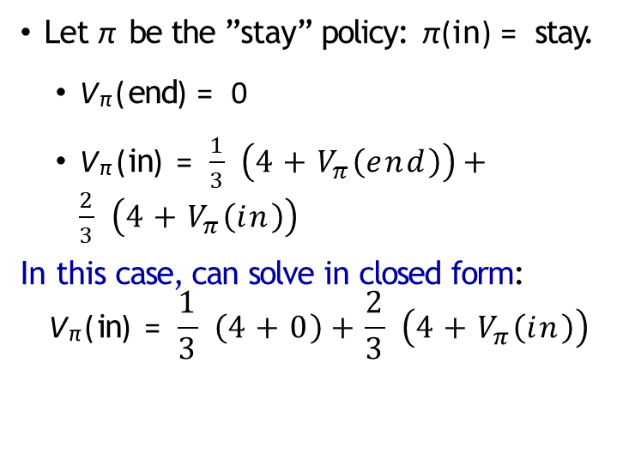
Dice Game
Let π be the ”stay” policy: π(in) = stay.
V_{π} (end) = 0
$\text{V}\text{π} \text{(}\text{in}\text{)}\text{ = }\frac{1}{3} \left(4+V_{π}\left(end\right)\right)+\frac{2}{3} \left(4+V_{π}\left(in\right)\right)$
In this case, can solve in closed form:
$$\text{V}\text{π} \text{(}\text{in}\text{)}\text{ = }\frac{1}{3} \left(4+0\right)+\frac{2}{3} \left(4+V_{π}\left(in\right)\right)$$
In
stay
in, stay
(2/3): $4
(1/3) : $4
quit
in, quit
end
1: $10

Slide 32

Dice Game
Let π be the ”stay” policy: π(in) = stay.
V_{π} (end) = 0
$\text{V}\text{π} \text{(}\text{in}\text{)}\text{ = }\frac{1}{3} \left(4+V_{π}\left(end\right)\right)+\frac{2}{3} \left(4+V_{π}\left(in\right)\right)$
In this case, can solve in closed form:
$$\text{V}\text{π} \text{(}\text{in}\text{)}\text{ = }\frac{4}{3}+\frac{2}{3} \left(4+V_{π}\left(in\right)\right)$$
In
stay
in, stay
(2/3): $4
(1/3) : $4
quit
in, quit
end
1: $10

Slide 33
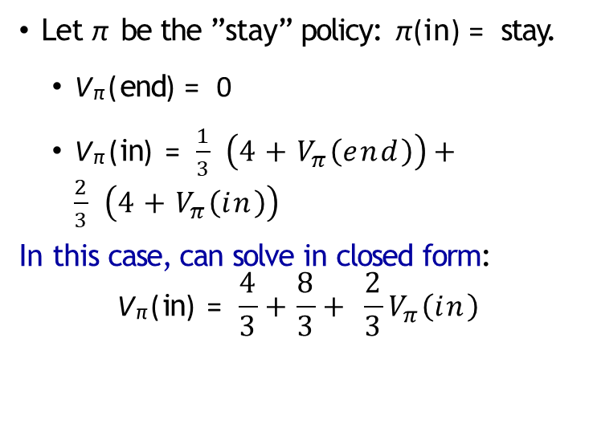
Dice Game
Let π be the ”stay” policy: π(in) = stay.
V_{π} (end) = 0
$\text{V}\text{π} \text{(}\text{in}\text{)}\text{ = }\frac{1}{3} \left(4+V_{π}\left(end\right)\right)+\frac{2}{3} \left(4+V_{π}\left(in\right)\right)$
In this case, can solve in closed form:
$$\text{V}\text{π} \text{(}\text{in}\text{)}\text{ = }\frac{4}{3}+\frac{8}{3}+ \frac{2}{3}V_{π}\left(in\right)$$
In
stay
in, stay
(2/3): $4
(1/3) : $4
quit
in, quit
end
1: $10

Slide 34

Dice Game
Let π be the ”stay” policy: π(in) = stay.
V_{π} (end) = 0
$\text{V}\text{π} \text{(}\text{in}\text{)}\text{ = }\frac{1}{3} \left(4+V_{π}\left(end\right)\right)+\frac{2}{3} \left(4+V_{π}\left(in\right)\right)$
In this case, can solve in closed form:
$$\text{V}\text{π} \text{(}\text{in}\text{)}\text{ = }\frac{12}{3}+ \frac{2}{3}V_{π}\left(in\right)$$
In
stay
in, stay
(2/3): $4
(1/3) : $4
quit
in, quit
end
1: $10

Slide 35

Dice Game
Let π be the ”stay” policy: π(in) = stay.
V_{π} (end) = 0
$\text{V}\text{π} \text{(}\text{in}\text{)}\text{ = }\frac{1}{3} \left(4+V_{π}\left(end\right)\right)+\frac{2}{3} \left(4+V_{π}\left(in\right)\right)$
In this case, can solve in closed form:
$$\text{V}\text{π} \text{(}\text{in}\text{)}\text{ = }4 + \frac{2}{3}V_{π}\left(in\right)$$
In
stay
in, stay
(2/3): $4
(1/3) : $4
quit
in, quit
end
1: $10

Slide 36

Dice Game
Let π be the ”stay” policy: π(in) = stay.
V_{π} (end) = 0
$\text{V}\text{π} \text{(}\text{in}\text{)}\text{ = }\frac{1}{3} \left(4+V_{π}\left(end\right)\right)+\frac{2}{3} \left(4+V_{π}\left(in\right)\right)$
In this case, can solve in closed form:
$$\text{V}\text{π} \text{(}\text{in}\text{)}\text{ = }12$$
In
stay
in, stay
(2/3): $4
(1/3) : $4
quit
in, quit
end
1: $10

Slide 37

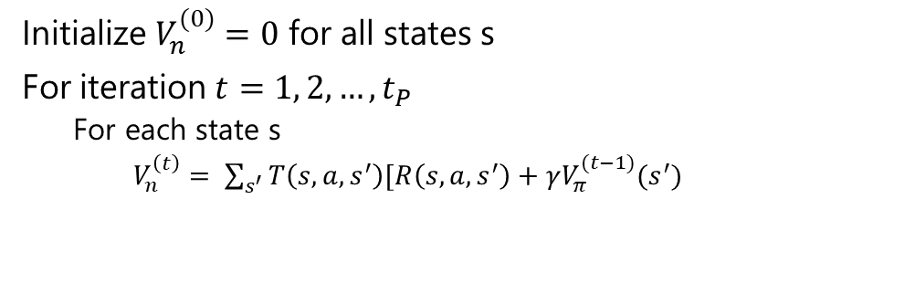
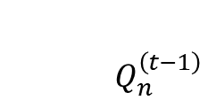
Policy Evaluation
Key Idea: Iterative Algorithm
Start with arbitrary policy values and repeatedly apply recurrences to converge to true values.
Algorithm: policy evaluation
Initialize $V_{n}^{(0)}=0$ for all states s
For iteration $t=1, 2, …, t_{P}$
For each state s
$V_{n}^{\left(t\right)}= \sum_{s^{′}}{T\left(s,a,s^{′}\right)[R\left(s,a,s^{′}\right)+γV_{π}^{(t−1)}(s^{′})}$
$Q_{n}^{\left(t−1\right)}$

Slide 38
Policy Evaluation Computations
V ^{(t)}(s)
π
iteration t
0
0
0
0
0
state s

Slide 39
Policy Evaluation Computations
V ^{(t)}(s)
π
iteration t
0 | -0.1
0 | -0.1
0 | 4
0 | -0.1
0 | -0.1
state s

Slide 40
Policy Evaluation Computations
V ^{(t)}(s)
π
iteration t
0 | -0.1 | -0.2
0 | -0.1 | 1.8
0 | 4 | 4
0 | -0.1 | 1.8
0 | -0.1 | -0.2
state s

Slide 41
Policy Evaluation Computations
V ^{(t)}(s)
π
iteration t
0 | -0.1 | -0.2 | 0.7
0 | -0.1 | 1.8 | 1.8
0 | 4 | 4 | 4
0 | -0.1 | 1.8 | 1.8
0 | -0.1 | -0.2 | 0.7
state s

Slide 42
Policy Evaluation Computations
V ^{(t)}(s)
π
iteration t
0 | -0.1 | -0.2 | 0.7 | 1.1
0 | -0.1 | 1.8 | 1.8 | 2.2
0 | 4 | 4 | 4 | 4
0 | -0.1 | 1.8 | 1.8 | 2.2
0 | -0.1 | -0.2 | 0.7 | 1.1
state s

Slide 43
Policy Evaluation Computations
V ^{(t)}(s)
π
iteration t
0 | -0.1 | -0.2 | 0.7 | 1.1 | 1.6
0 | -0.1 | 1.8 | 1.8 | 2.2 | 2.4
0 | 4 | 4 | 4 | 4 | 4
0 | -0.1 | 1.8 | 1.8 | 2.2 | 2.4
0 | -0.1 | -0.2 | 0.7 | 1.1 | 1.6
state s

Slide 44
Policy Evaluation Computations
V ^{(t)}(s)
π
iteration t
0 | -0.1 | -0.2 | 0.7 | 1.1 | 1.6 | 1.9
0 | -0.1 | 1.8 | 1.8 | 2.2 | 2.4 | 2.7
0 | 4 | 4 | 4 | 4 | 4 | 4
0 | -0.1 | 1.8 | 1.8 | 2.2 | 2.4 | 2.7
0 | -0.1 | -0.2 | 0.7 | 1.1 | 1.6 | 1.9
state s

Slide 45
Policy Evaluation Computations
V ^{(t)}(s)
π
iteration t
0 | -0.1 | -0.2 | 0.7 | 1.1 | 1.6 | 1.9 | 2.2
0 | -0.1 | 1.8 | 1.8 | 2.2 | 2.4 | 2.7 | 2.8
0 | 4 | 4 | 4 | 4 | 4 | 4 | 4
0 | -0.1 | 1.8 | 1.8 | 2.2 | 2.4 | 2.7 | 2.8
0 | -0.1 | -0.2 | 0.7 | 1.1 | 1.6 | 1.9 | 2.2
state s

Slide 46
Policy Evaluation Computations
V ^{(t)}(s)
π
iteration t
0 | -0.1 | -0.2 | 0.7 | 1.1 | 1.6 | 1.9 | 2.2 | 2.4
0 | -0.1 | 1.8 | 1.8 | 2.2 | 2.4 | 2.7 | 2.8 | 3
0 | 4 | 4 | 4 | 4 | 4 | 4 | 4 | 4
0 | -0.1 | 1.8 | 1.8 | 2.2 | 2.4 | 2.7 | 2.8 | 3
0 | -0.1 | -0.2 | 0.7 | 1.1 | 1.6 | 1.9 | 2.2 | 2.4
state s

Slide 47
Policy Evaluation Computations
V ^{(t)}(s)
π
iteration t
0 | -0.1 | -0.2 | 0.7 | 1.1 | 1.6 | 1.9 | 2.2 | 2.4 | 2.6
0 | -0.1 | 1.8 | 1.8 | 2.2 | 2.4 | 2.7 | 2.8 | 3 | 3.1
0 | 4 | 4 | 4 | 4 | 4 | 4 | 4 | 4 | 4
0 | -0.1 | 1.8 | 1.8 | 2.2 | 2.4 | 2.7 | 2.8 | 3 | 3.1
0 | -0.1 | -0.2 | 0.7 | 1.1 | 1.6 | 1.9 | 2.2 | 2.4 | 2.6
state s

Slide 48
Number of Iterations in Policy Evaluation?
Repeat until values don’t change much:
Don’t store V ^{(t)} for each iteration t, need only last two:
max |V
s∈States
(t)
π
(s) − V
(t−1)
(s)| ≤ ϵ
π
_{V} (t) _{and V} (t−1)
π π

Slide 49
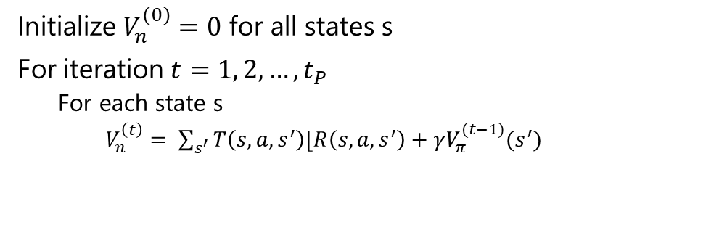
Complexity of Policy Evaluation
Algorithm: policy evaluation
Initialize $V_{n}^{(0)}=0$ for all states s
For iteration $t=1, 2, …, t_{P}$
For each state s
$V_{n}^{\left(t\right)}= \sum_{s^{′}}{T\left(s,a,s^{′}\right)[R\left(s,a,s^{′}\right)+γV_{π}^{(t−1)}(s^{′})}$
MDP complexity
S states
A actions per state
S′ successors (number of s′ with T (s, a, s′) > 0)
Time: O(t_{P}SS′)

Slide 50
Policy Evaluation on dice game
Let π be the ”stay” policy: π(in) = stay.
V ^{(t)}(end) = 0
V ^{(t)}(in) = ¹ (4 + V ^{(t−1)}(end)) + ² (4 + V ^{(t−1)}(in))
s | end | in
_{V} (t) π | 0.00 | 12.00
(t = 100 iterations)
Converges to V_{π} (in) = 12.
Notes:
Converges to V_{π} (in) = 12.

Slide 51
Summary
MDP: graph with states, chance nodes, transition probabilities, rewards
Policy: mapping from state to action (solution to MDP)
Value of policy: expected utility over random paths
Policy evaluation: iterative algorithm to compute value of policy

Slide 52
Value Iteration

Slide 53
Optimal V and Q-Value
Q_{opt}(s, a)
s, a
_{s}′
V_{opt}(s′)
T (s, a, s′)
a
V_{opt}(s)
s

Slide 54
Optimal Policies
Given Q_{opt}, read off the optimal policy:
π_{opt}(s) = arg
max Q_{opt}(s, a)
a∈Actions(s)

Slide 55
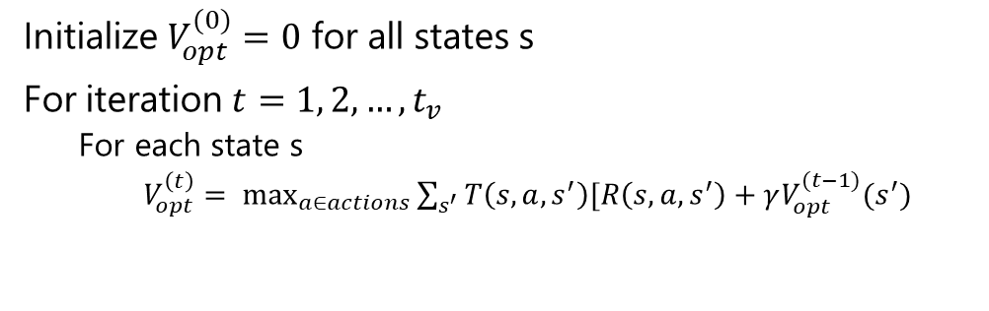
Value Iteration
Algorithm: Value Iteration
Initialize $V_{opt}^{(0)}=0$ for all states s
For iteration $t=1, 2, …, t_{v}$
For each state s
$V_{opt}^{\left(t\right)}= \max_{a∈actions}{\sum_{s^{′}}{T\left(s,a,s^{′}\right)[R\left(s,a,s^{′}\right)+γV_{opt}^{(t−1)}(s^{′})}}$
Time: O(t_{V}SAS′)

Slide 56
Value Iteration for Dice Game
s | end | in
_{V} (t) π | 0.00 | 12.00
(t = 100 iterations)
π_{opt}(s) = Stay

Slide 57
Value Iteration for Bridge Crossing

Slide 58
Summary
Markov decision processes (MDPs) cope with uncertainty
Solutions are policies rather than paths
Policy evaluation computes policy value (expected utility)
Value iteration computes optimal value (maximum expected util- ity) and optimal policy
Main technique: write recurrences → algorithmNext time: reinforcement learning — when we don’t know rewards, transition probabilities

